Slide 2
Shortest path first

Slide 3
AGENDA
This presentation is submitted in Partial Fulfillment of the Requirements for the Course of Minor Project - I
In Third year – Fifth Semester of Bachelor of Technology specialization In Oil and Gas Informatics Under
Mrs. Niharika Singh

Slide 4
MEET OUR TEAM
ADITI SINGH
R970219003
500076022
DIYA AGARWAL
R970219009
500077155
SUMIT KR. RANA
R970219016
500076729
Research, Coding, Testing, Documentation
Research, Coding, Testing, Documentation
Research, Coding, Testing, Documentation

Slide 5
Index
Introduction
Problem Statement
Objective
Application of the Project
List of Libraries
Data set
Data Structure and Algorithm
Methodology
Progress Output
Technical Diagrams
SWOT Analysis
Plan for work
References

Slide 6
introduction
In a world where staying home is the new normal, ordering food online has become more of a habit than an occasion.
Everyone likes a fast and simple interface to order their cravings.
Now, no one likes their food to arrive cold, but most of the time this is a common lapse with every food delivery app.
This problem arises due to various factors, but a major one is taking the longer route or getting stuck in traffic.
Thus comparing multiple routes and coming up with the shortest one is invaluable.

Slide 7
Problem Statement
Analysis of the shortest path from restaurants to delivery point by comparative study of shortest path calculation algorithms and congestion control.

Slide 8
objective
Our program will be designed to compare every route connecting a restaurant and a customer with 3 different algorithms to ensure the fastest delivery.
It will be equipped with the necessary datasets for information storage and use.
The program will also focus on the congestion control at junctions, if any and enable rerouting to serve the purpose of on-time delivery.

Slide 9
Application of the project
The area of application for our program can be on any practical food ordering website/application existing or upcoming.
Another application of our project can be for any delivery application that will take advantage of the congestion control we will be implementing to make faster and more efficient deliveries.

Slide 10
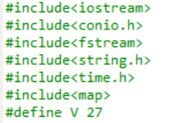
List of libraries
We have used basic libraries like- <iostream.h>,<conio.h>,<string.h>,<fstream.h>,<time.h>,<map.h> that will contain all the essential components required for coding.
<fstream.h> is used for inclusion of file handling .
<time.h> will be used to produce random numbers using the function “RAND”.
<map.h> has been used to store data set in key-value pair.

Slide 11
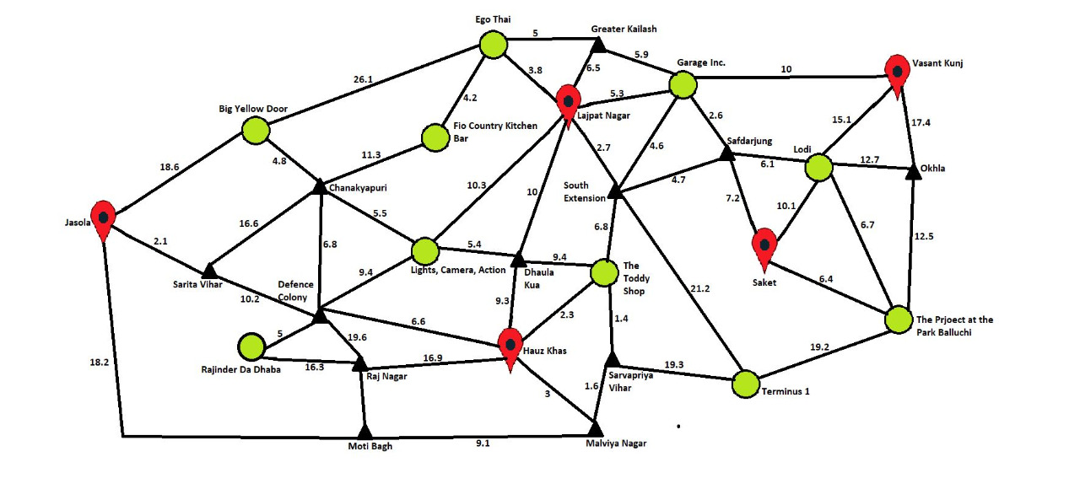
Data set

Slide 12
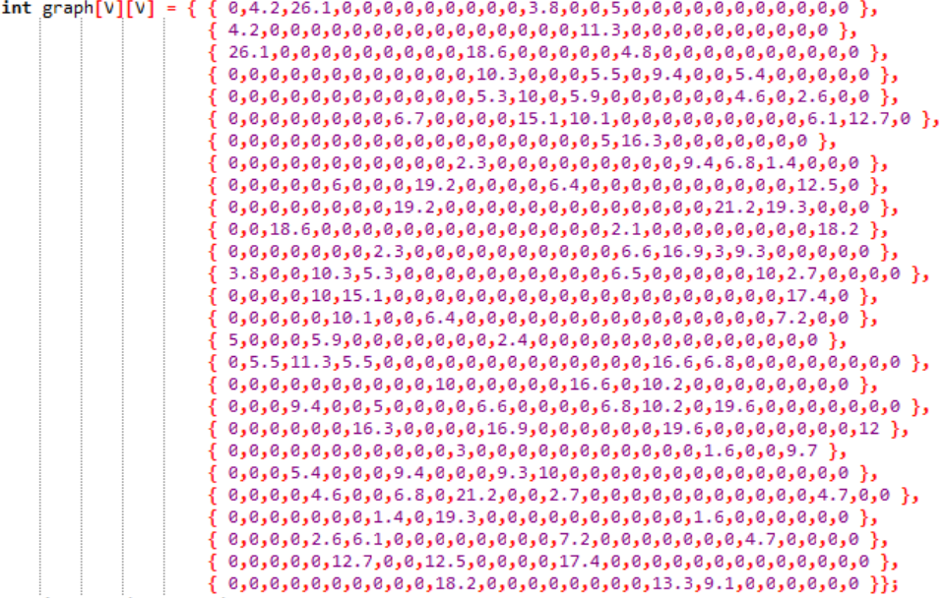
Data set

Slide 13
Data Structure and Algorithms
Arrays- 1D & 2D
Maps
Dijkstra Algorithm
A* Algorithm
Travelling Salesman Problem

Slide 14
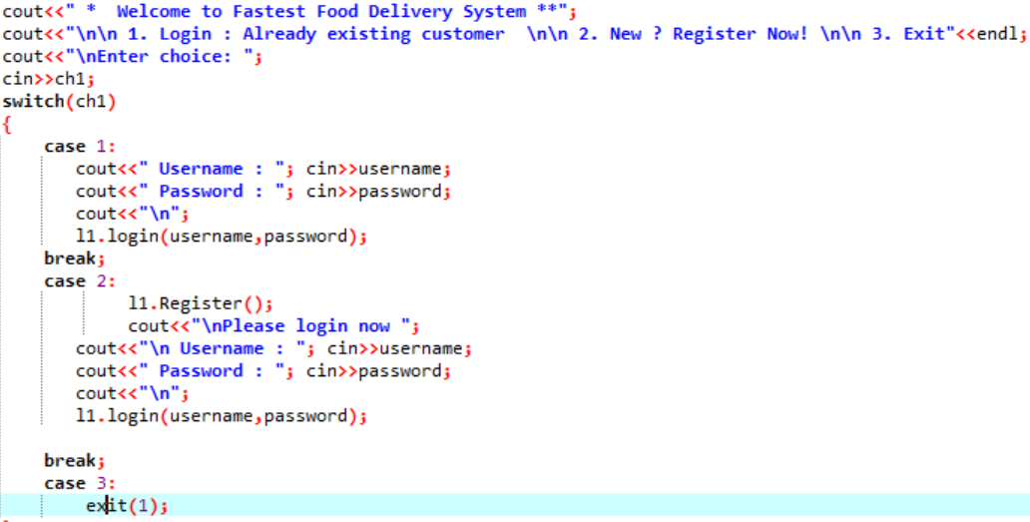
methodology
Step 1: Overall we have used File handling, Maps, Created functions, Conditional Statements, various Data types and implemented algorithms, along with required libraries. So our program runs with the help of these components.
Step 2: Firstly we have provided user with a registration/login interface which is linked to a file. On correct credentials the user gets logged in into the system.

Slide 15
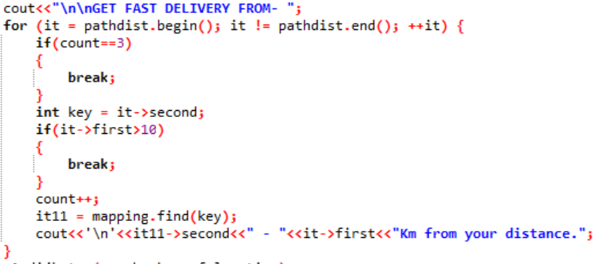
methodology
Step 3: Then the user is prompted to select delivery points from a given list. On selection, the program is functioned to display all the restaurants lying within 10kms. This is done with the help of maps.

Slide 16
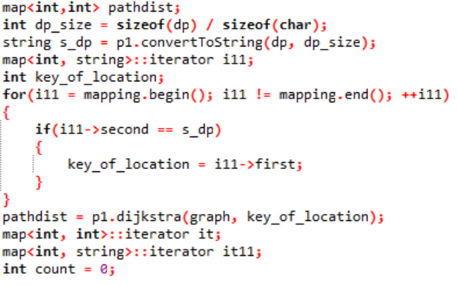
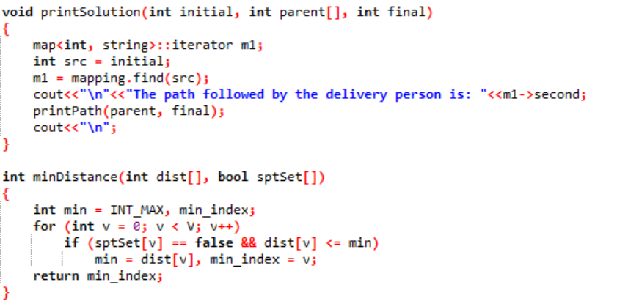
methodology
Step 4: After selecting the restaurant , the two locations are stored in 2 variables as source and destination. The key value pairs mapped are further stored in an array after which the Dijkstra algorithm is applied.
In this module we have various helper functions such as minDistance() which calculates the node of minimum value, convertTo String() for converting the char array into string for easy access, multimap<> which helped in sorting according to values, sptSet[] for keeping the count on the nodes visited, parent[] for nodes travelled etc.

Slide 17
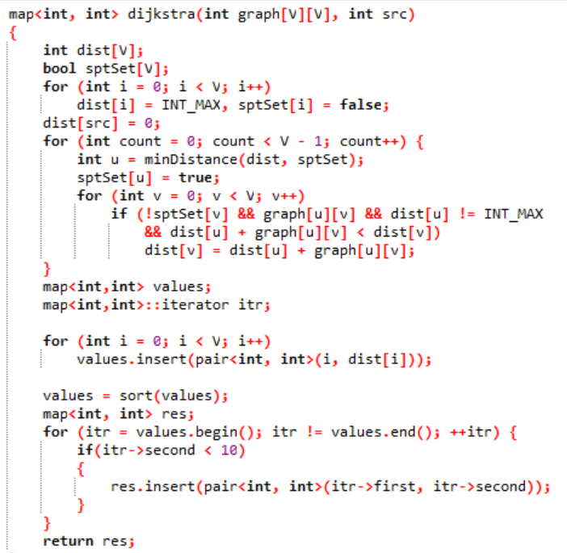
methodology

Slide 18
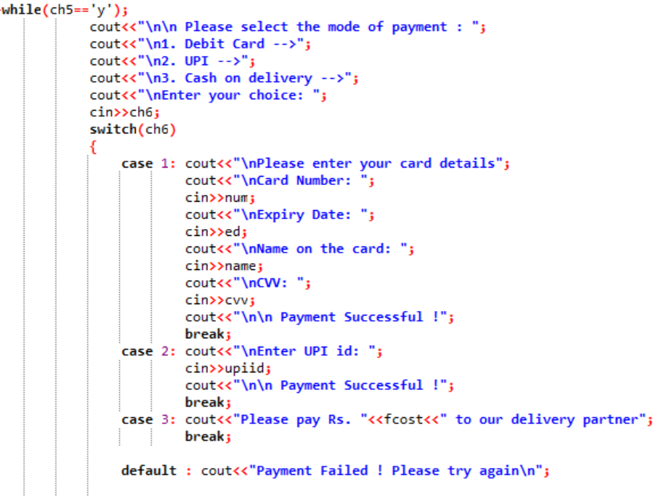
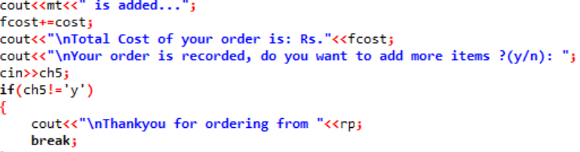
methodology
Step 5: On selecting the restaurant, menu is displayed which prompts the user for the order to be placed. On the basis of items ordered the total cost is calculated and displayed to the user.
The user gets the liberty to choose mode of payment. According to which the needed information is asked. And the order is confirmed.

Slide 19
Progress output

Slide 20
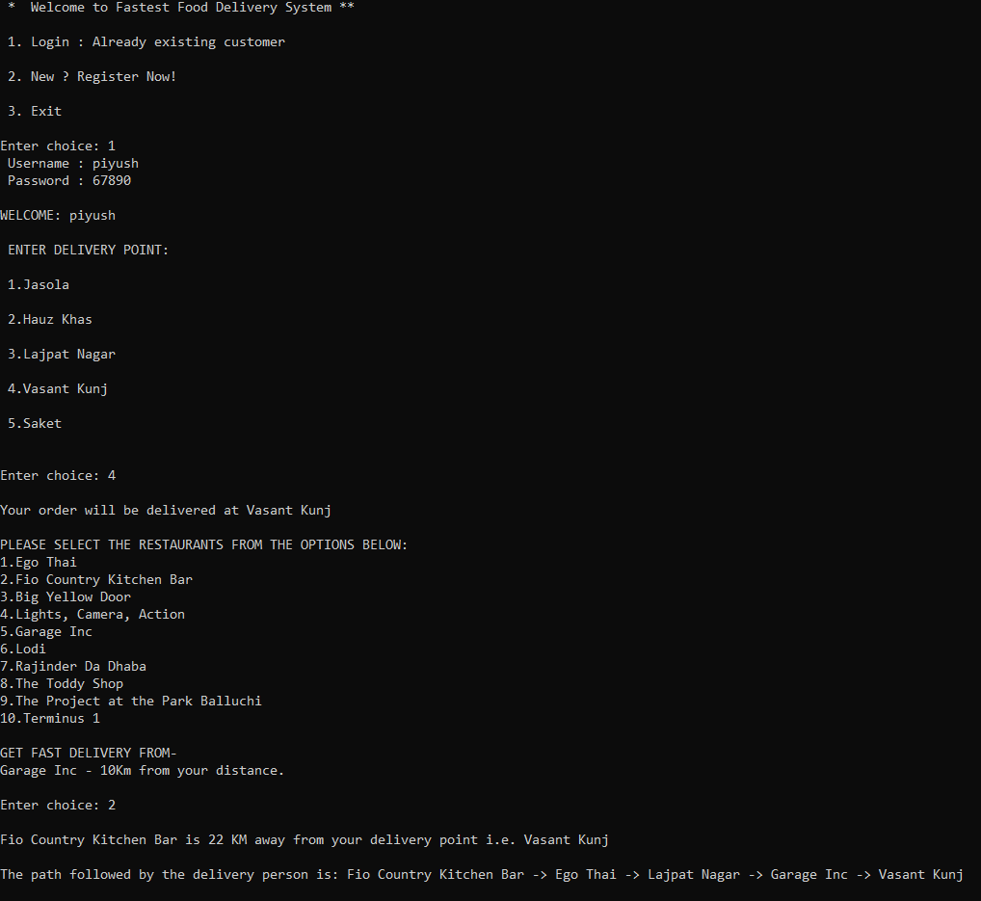
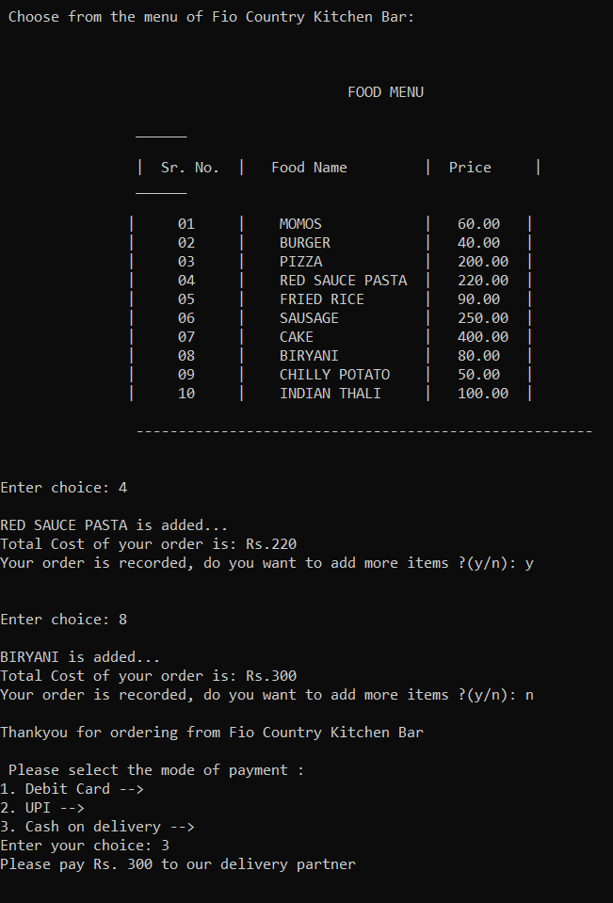

Slide 21
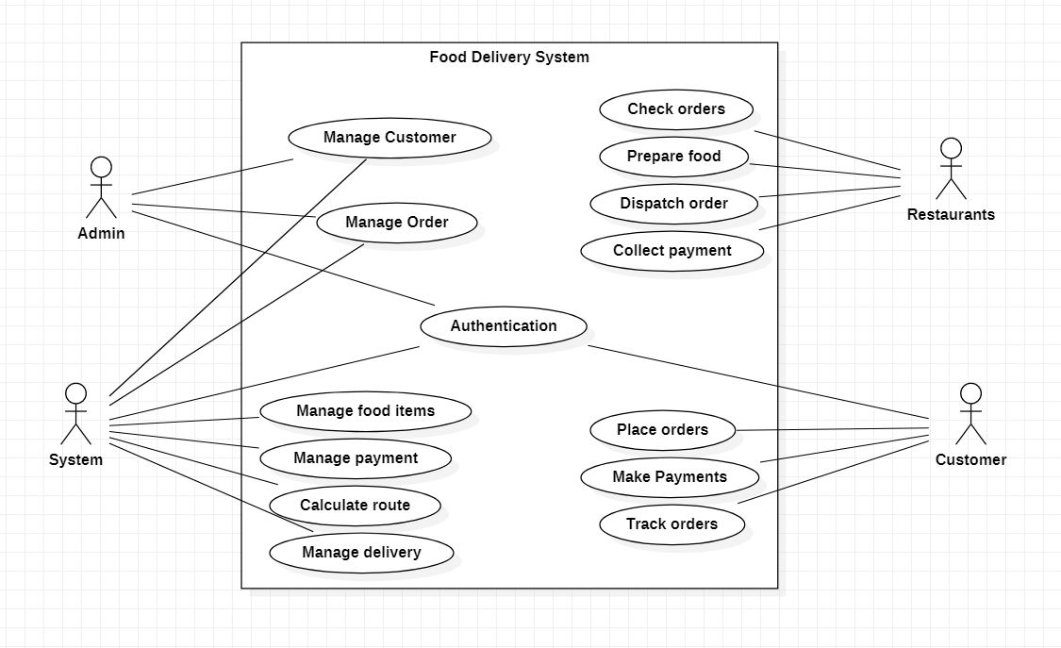
Diagrams
Use Case

Slide 22
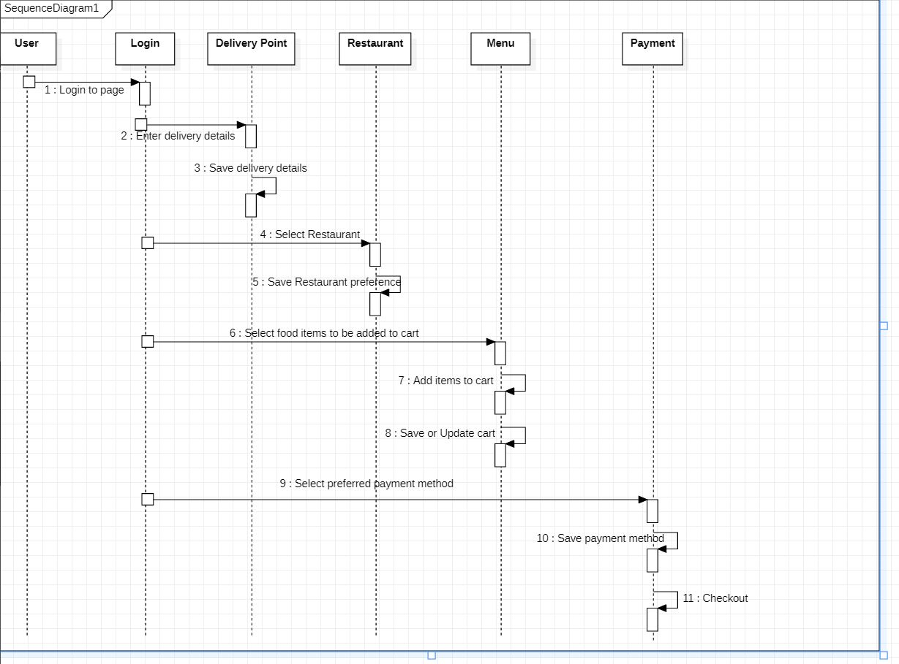
Diagrams
Sequence Diagram

Slide 23
Swot analysis
Strength:-
Our program aims to find the shortest route between a restaurant and customer by comparing 3 different algorithms to ensure the best optimality.
It also suggests nearby restaurants to users from their delivery points.
The program is designed to overcome congestion at junctions and reroute paths.

Slide 24
Swot analysis
Weakness:-
One practical drawback of the Dijkstra algorithm is it is a single source shortest path algorithm which consumes a lot of time increasing the time complexity.
In a situation where a customer resides at a place equally distant from a restaurant regardless of the path taken, optimality of the program will be at stake.

Slide 25
Swot analysis
Opportunity:-
There is an opportunity to allow the customer to pick-up their delivery from any location that intersects/lies in the route taken for delivery, in case of emergency.

Slide 26
Swot analysis
Threat:-
If a customer decides to order items from two separate restaurants in the same login phase, he will be denied for the same.

Slide 27
PLAN FOR work
3 Dec – 10 Dec
Requirement Analysis
22 Aug – 3 Sept
Research
3 Sept – 20 Sept
Design Analysis
20 Sept – 15 Oct
Coding/Testing
25 Oct – 3 Dec
Final Documentation

Slide 28
references
Let Us C++ by Yashwant Kanetkar
2) https://www.geeksforgeeks.org/dijkstras-shortest-path-algorithm-greedy-algo-7/
3) https://www.google.com/maps

Slide 29
THANK YOU

